Slide 1
Lesson 6: Quantum Computing

Slide 2
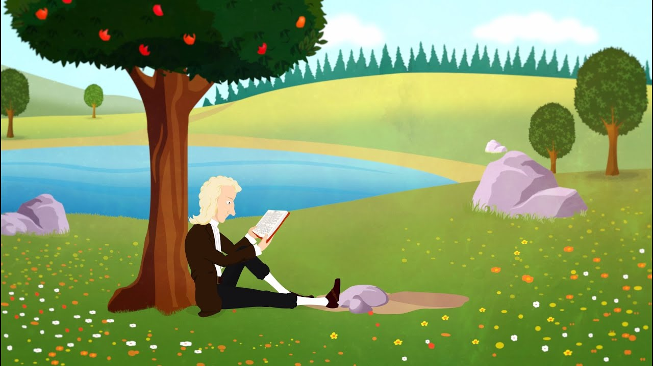



In the world we have classical physics

Slide 3
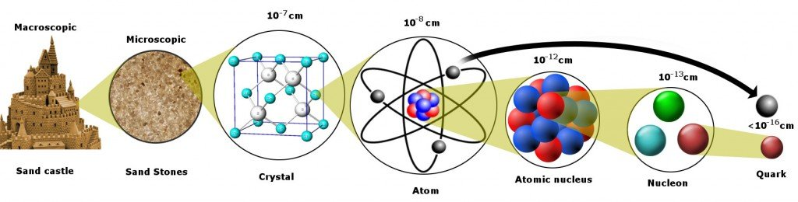

Slide 4

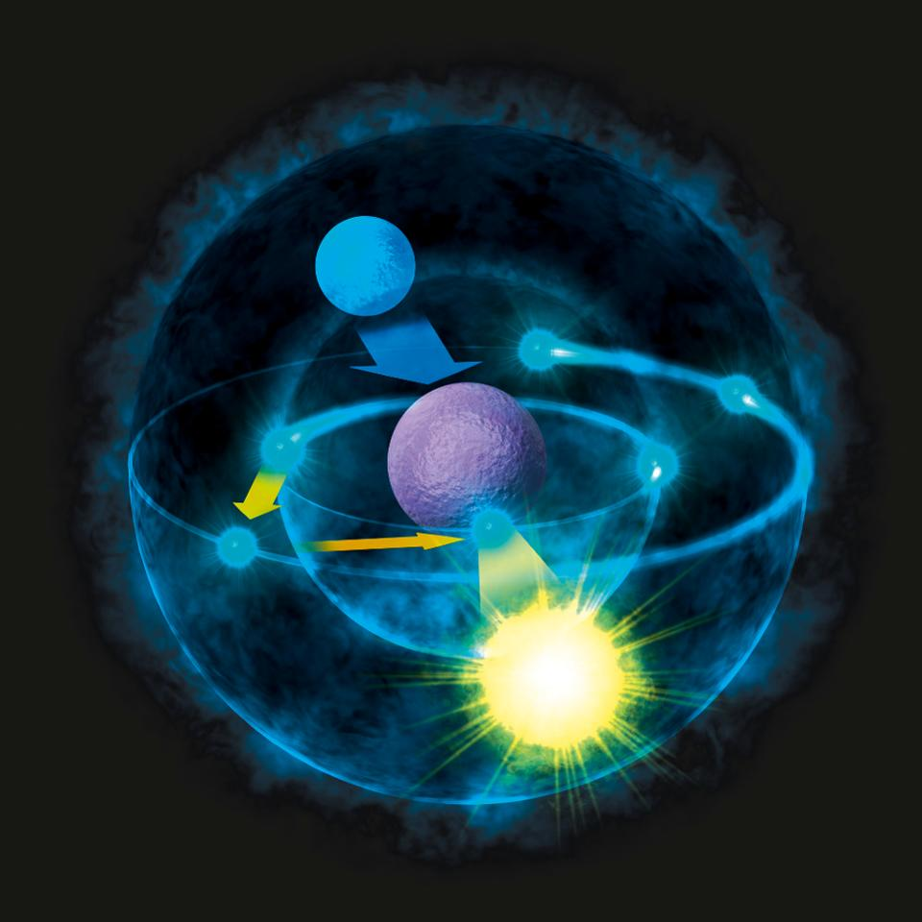
The teeny tiny world does not play by the same rules

Slide 5
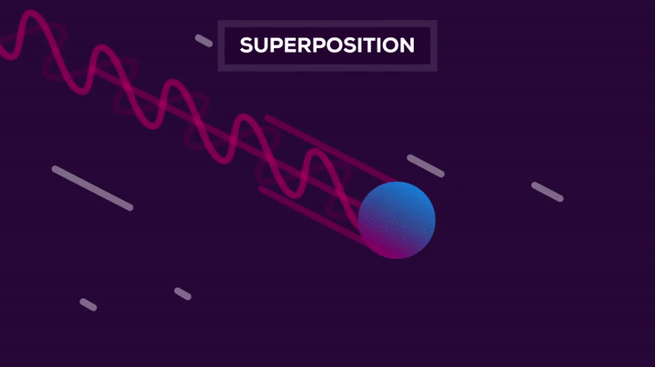
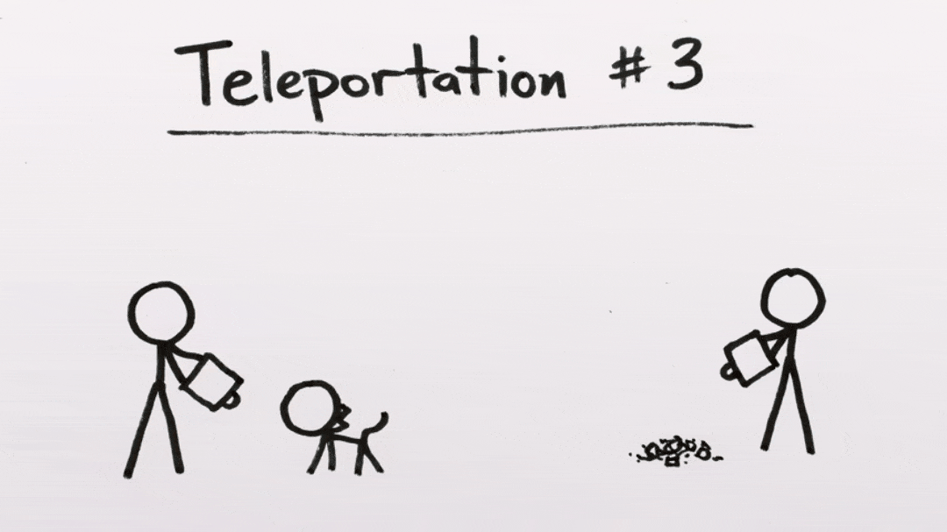
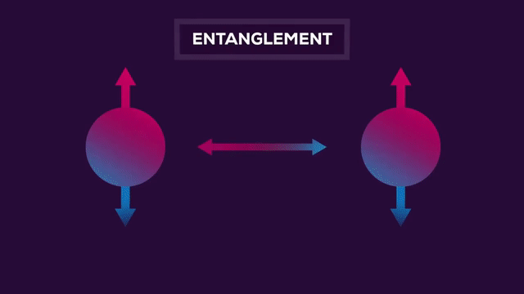
The teeny tiny world is a spooky place where weird things happen

Slide 6

How can this be?

Slide 7
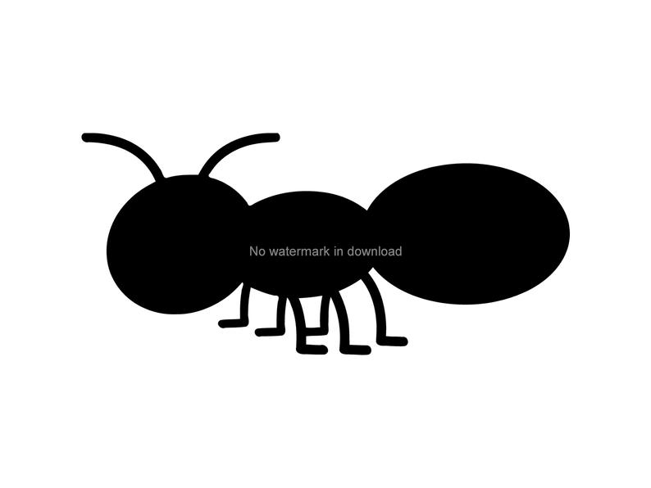


The same way ant physics is different to elephant physics because they are so much smaller
Ants also cant die from falling

Slide 8
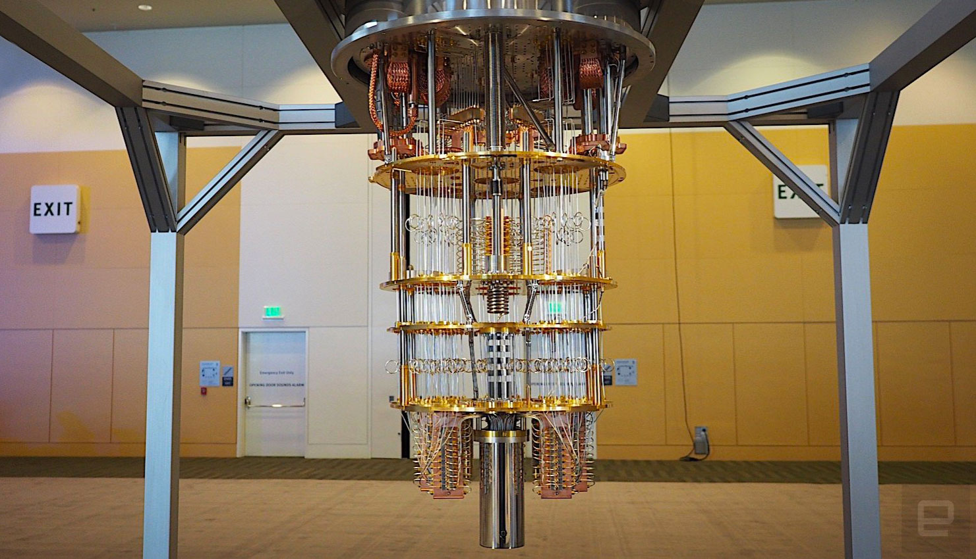
Quantum computers follow the rules of tiny world physics

Slide 9
Instead of bits (1, 0) They have qubits

Slide 10


Quantum computers are very new, and will never replace classical computers.
They are not very powerful at the moment but will one day help with things like medicine (its teeny tiny) and cyber security
In 2018 there were only 11 quantum computers in the world, but you can code one and play with one.

